Slide 1
TIME SERIES ANALYSIS
A time series is a sequence of measurements done over time, usually obtained at equally spaced intervals, be it daily, monthly, quarterly or yearly.
Time series data: A set of observations on the values that a variable takes at different times.
Eg.
Daily air temperature or monthly precipitation in Pune
Daily closing stock prices

Slide 2
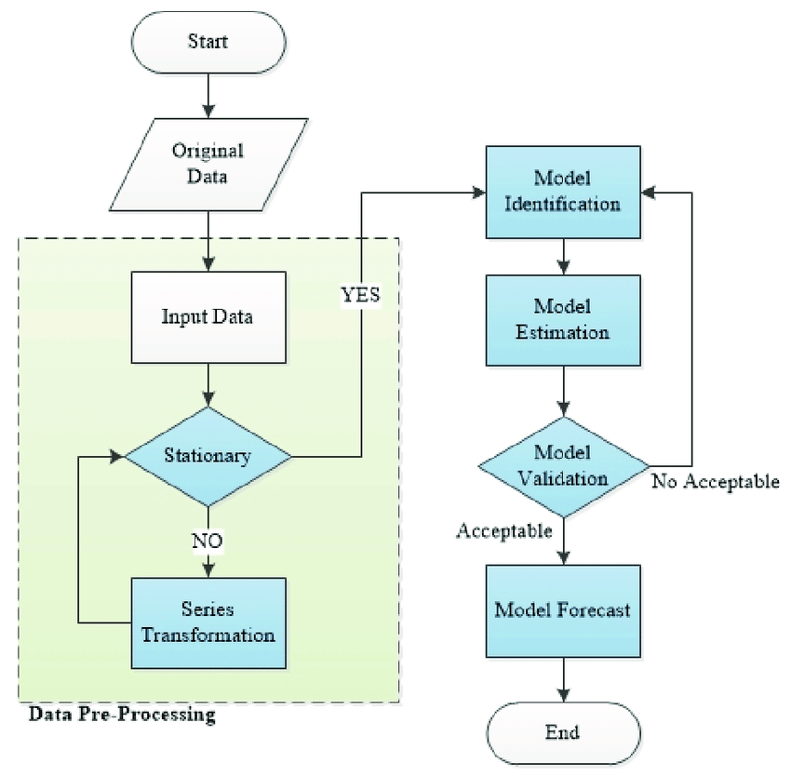
Time series analysis Flow
Series Stationarity Identification
Time Series plot of the series
Check for possible outliers
Check for the existence of a trend or seasonality
Remove the trend and the seasonal component to get stationary residuals
Estimation
MME,MLE
Validation
Normality of error terms
Independency of error terms
Constant error variance (Homoscedasticity)
Forecasting
Exponential smoothing methods
Minimum MSE forecasting

Slide 3
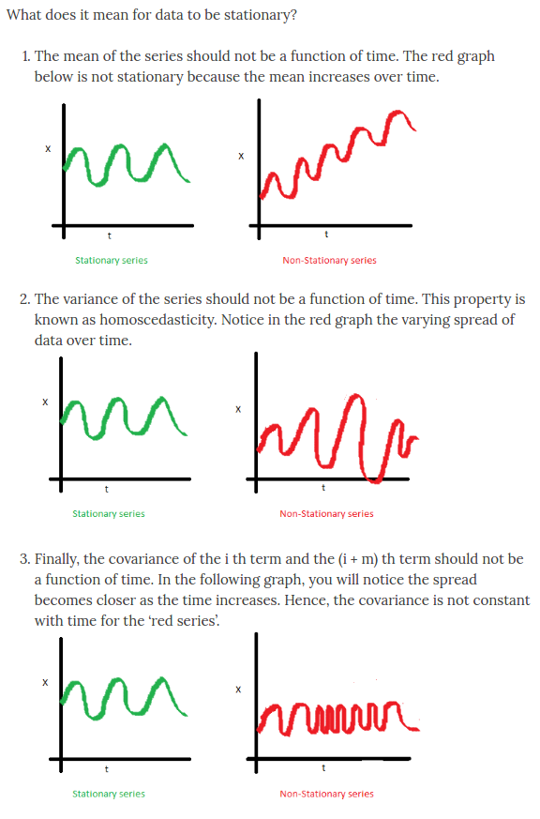
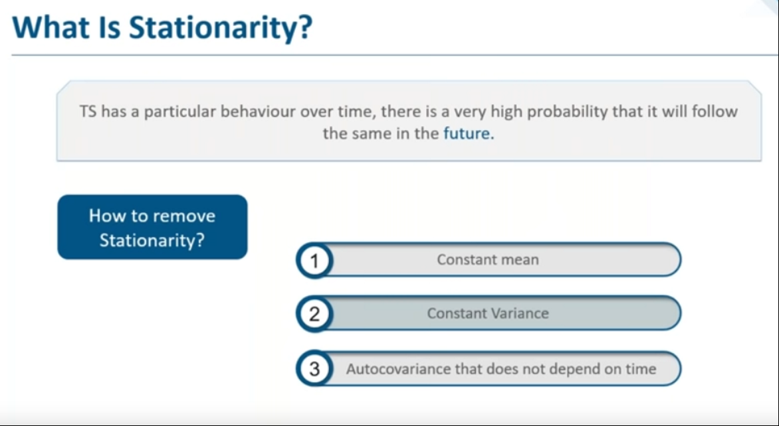
Stationarity
The basic idea of stationarity is that the probability laws governing the process do not change with time.

Slide 4
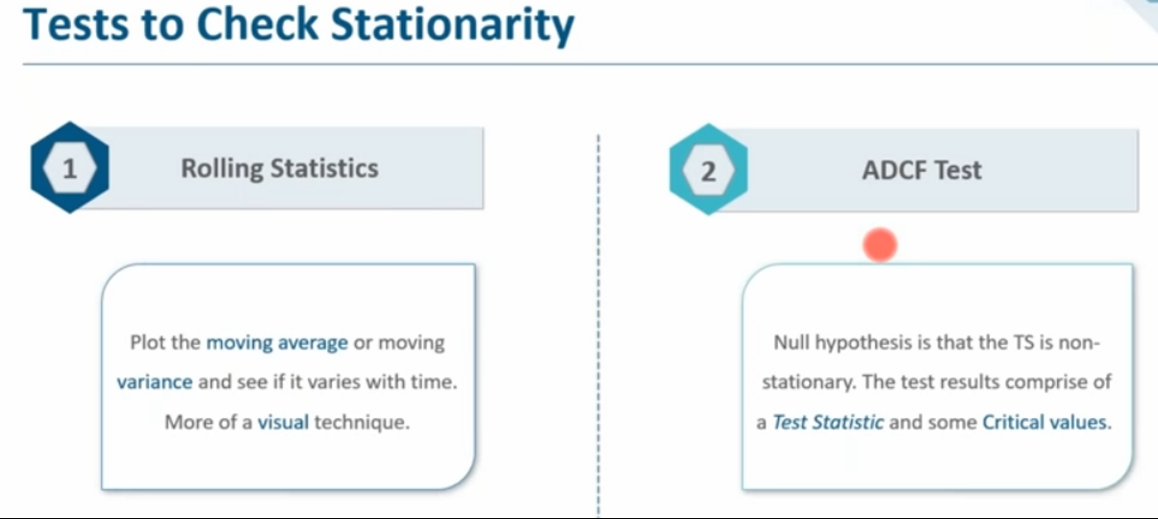
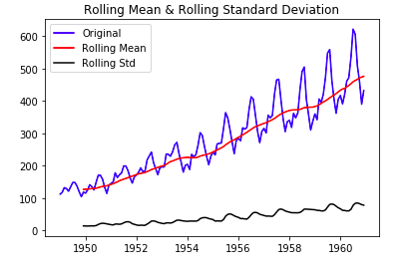
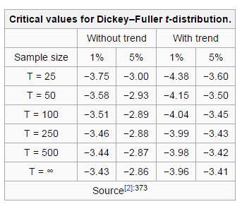
Stationarity check

Slide 5
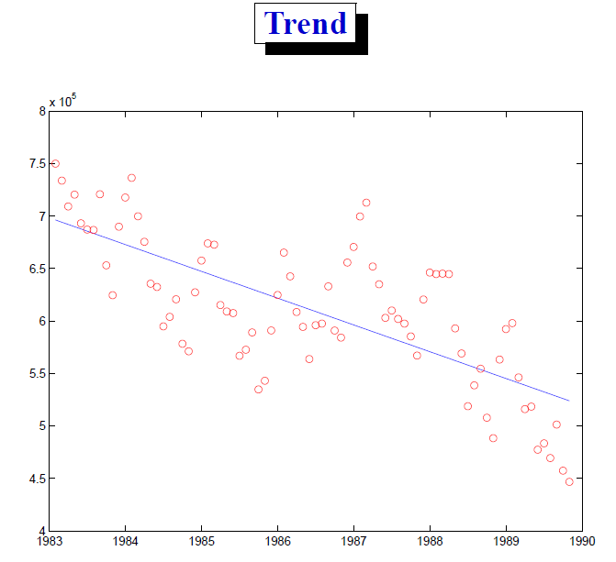
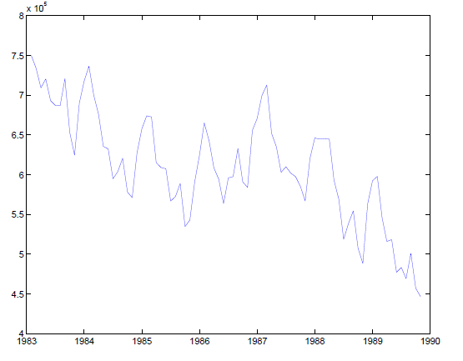
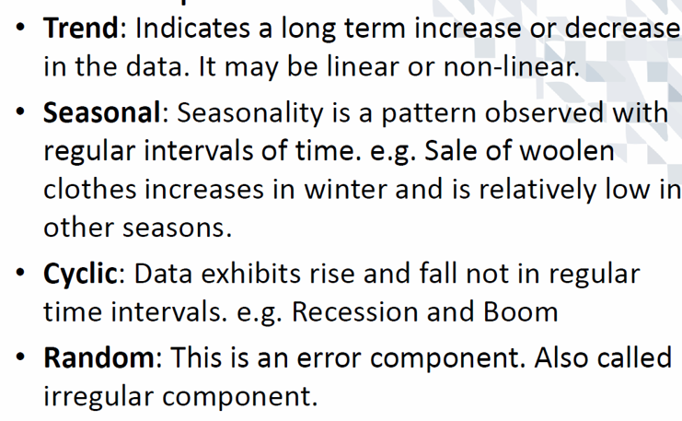
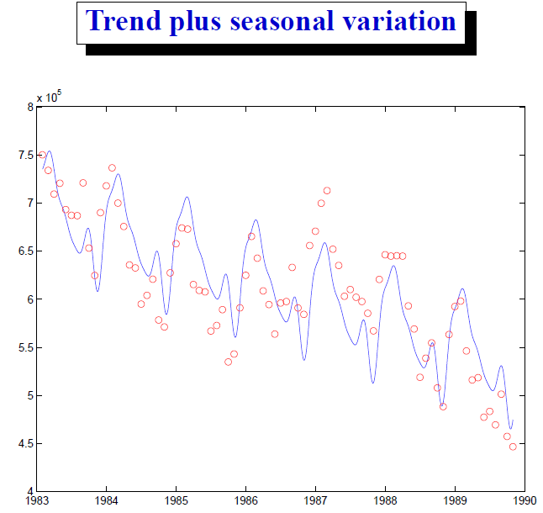
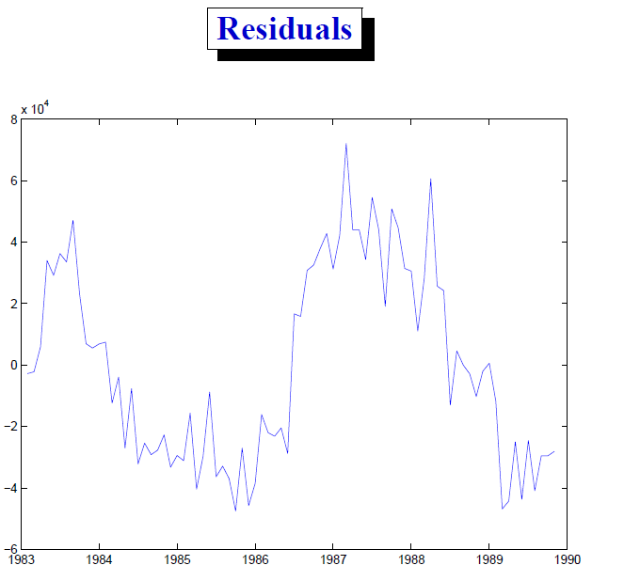
Components of time series

Slide 6
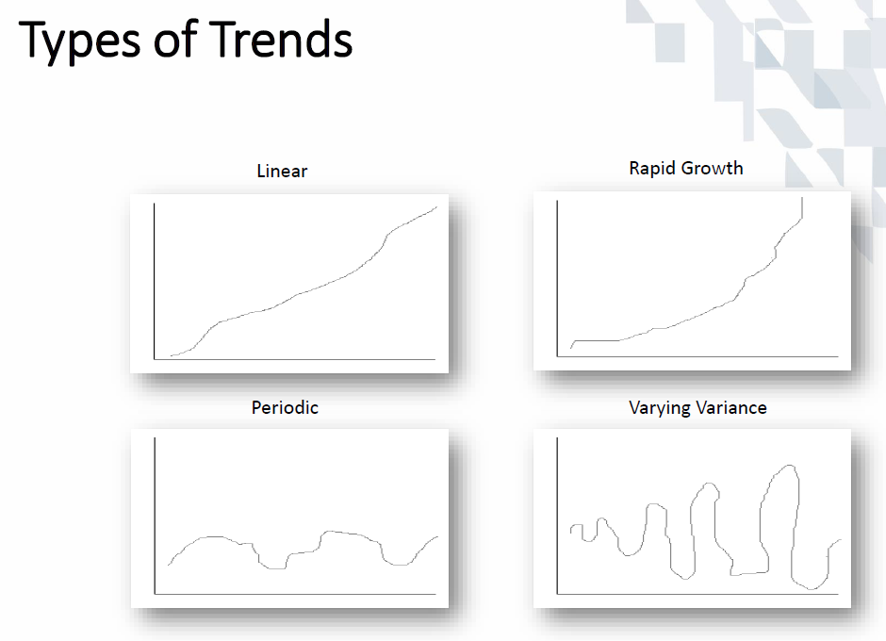
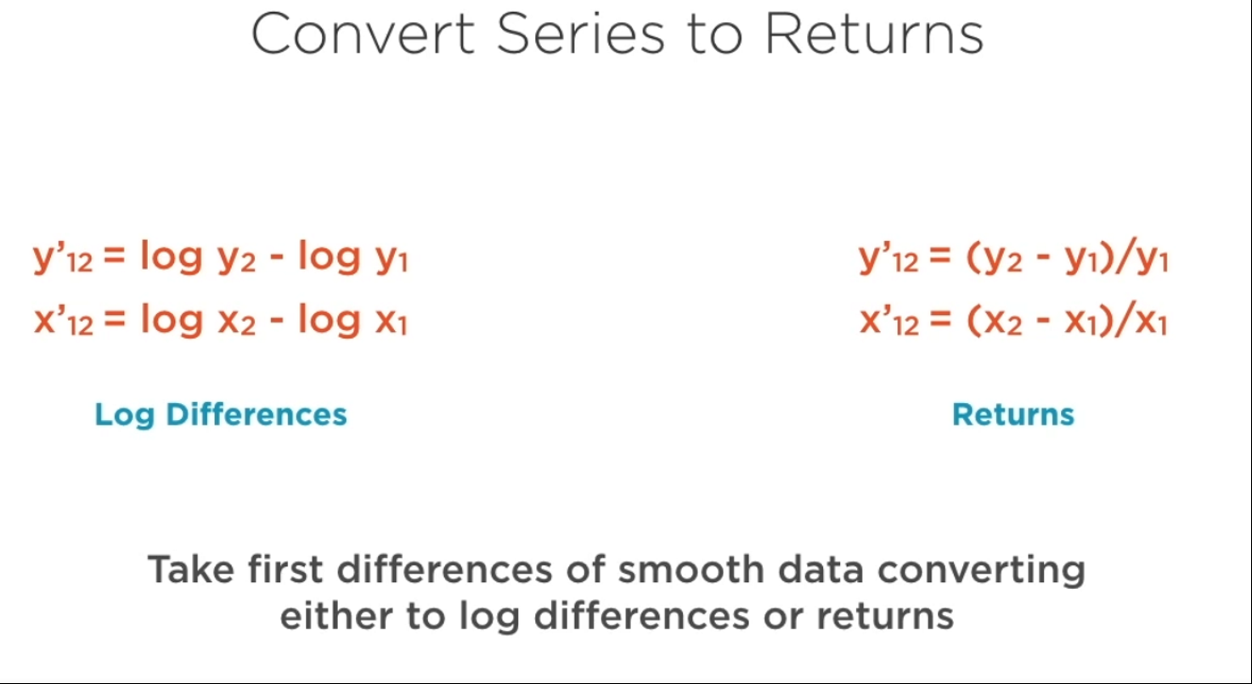
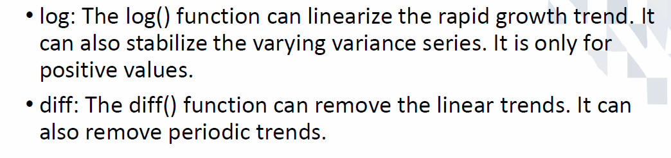
Type of tends

Slide 7
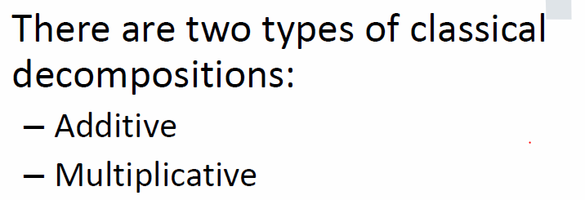
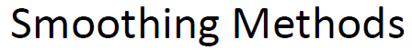
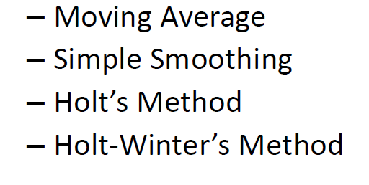
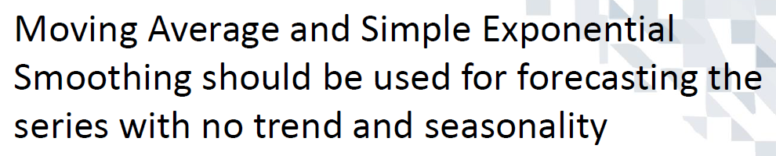
Decomposition and Smoothing
Done by subtracting the trend estimates from the series.
Done by dividing the series by the trend values.

Slide 8
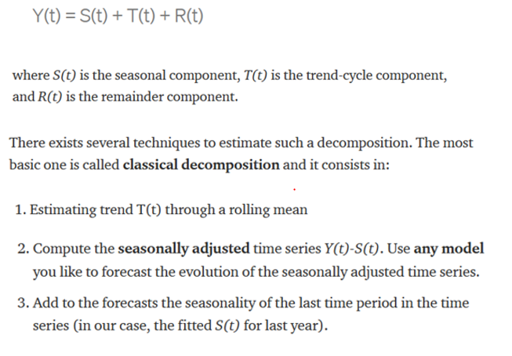
Seasonality
Seasonality
Holt-Winter's Additive Method − When the seasonality is additive in nature.
Holt-Winter’s Multiplicative Method − When the seasonality is multiplicative in nature.

Slide 9

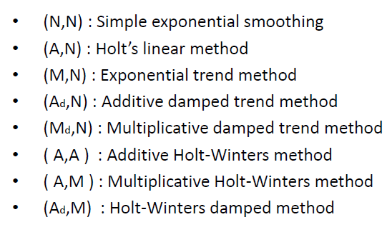



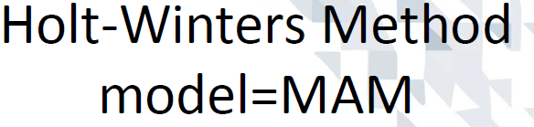
Exponential models based on error ,trend, seasonality decomposition
Eg. (“MAM”)multiplicative error, additive trend, and multiplicative seasonality

Slide 10
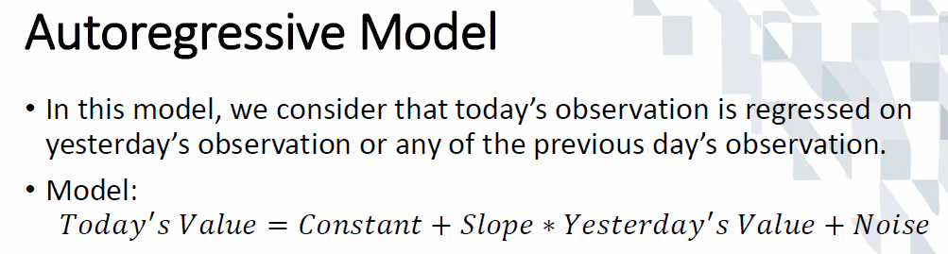
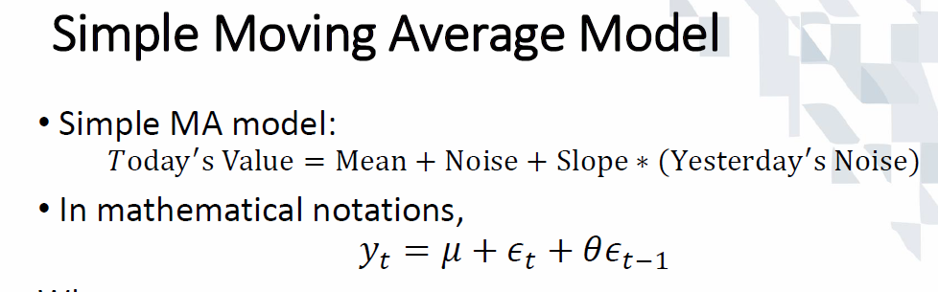
AR ,MA Modelling
the output variable depends linearly on its own previous values and on a stochastic term
output variable depends linearly on the current and various past values of a stochastic term.

Slide 11
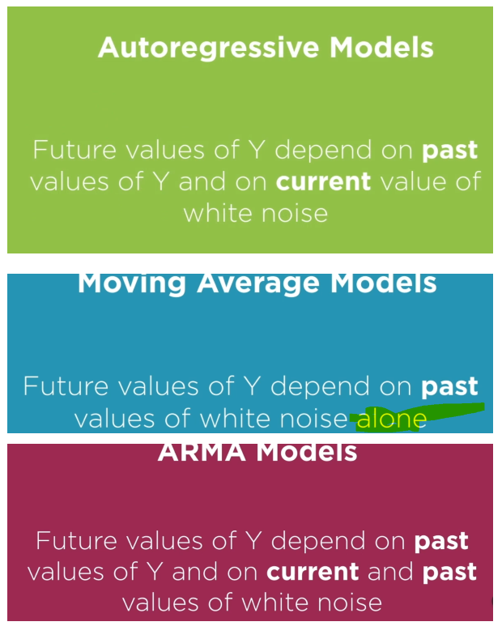
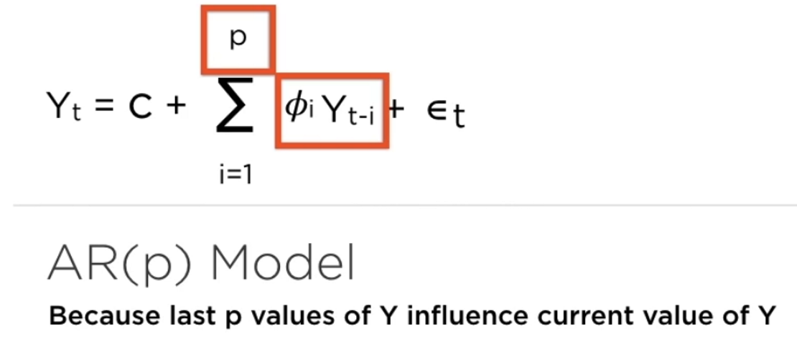
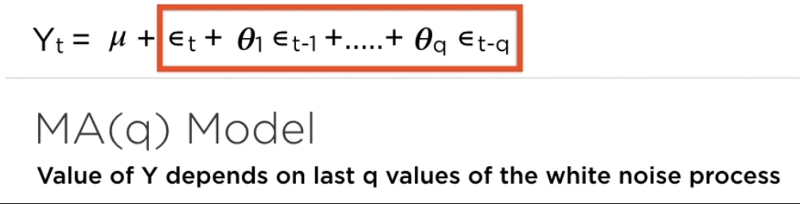
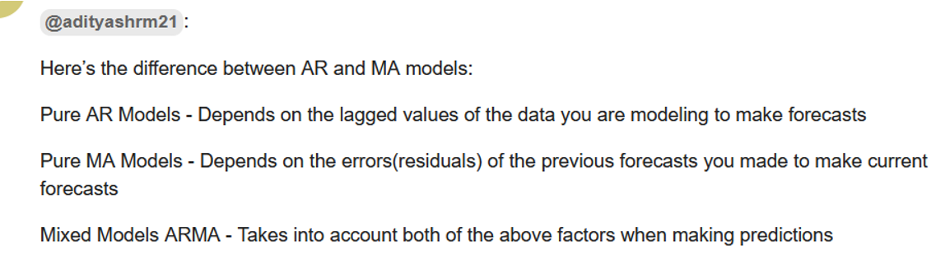
Different models

Slide 12
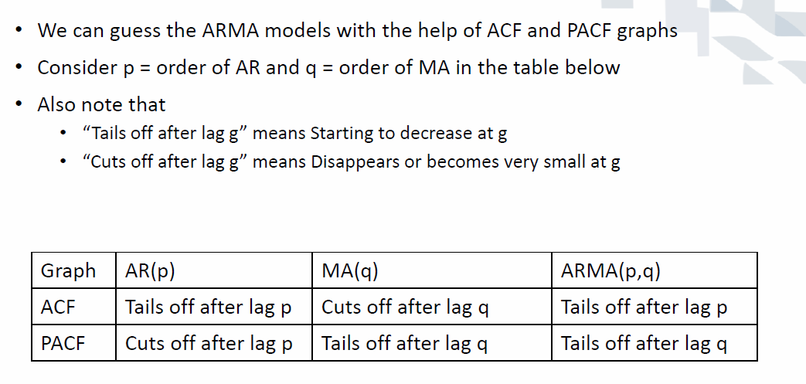
Finding right model

Slide 13
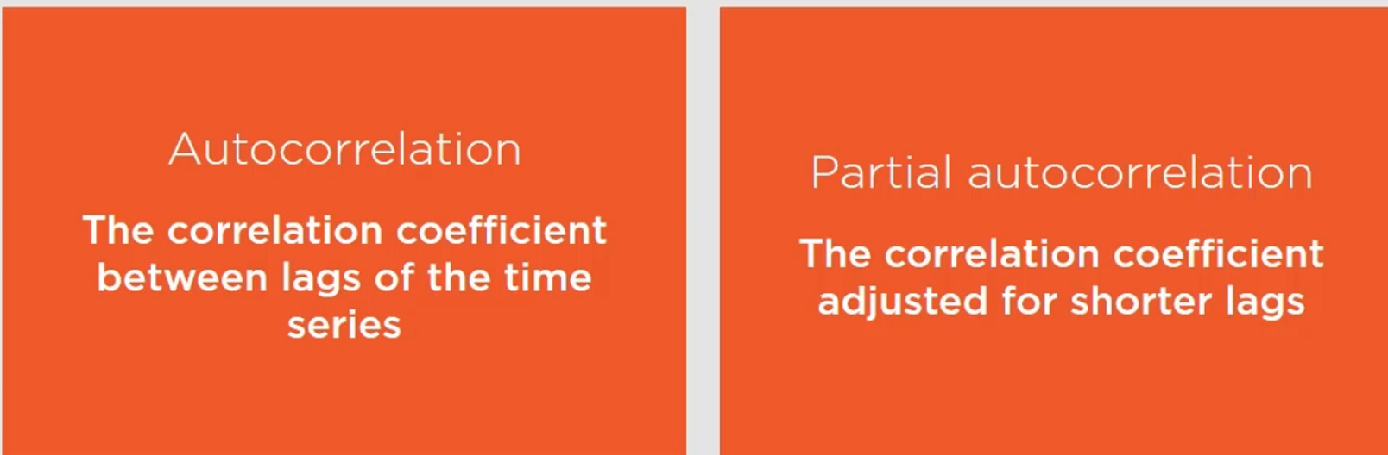
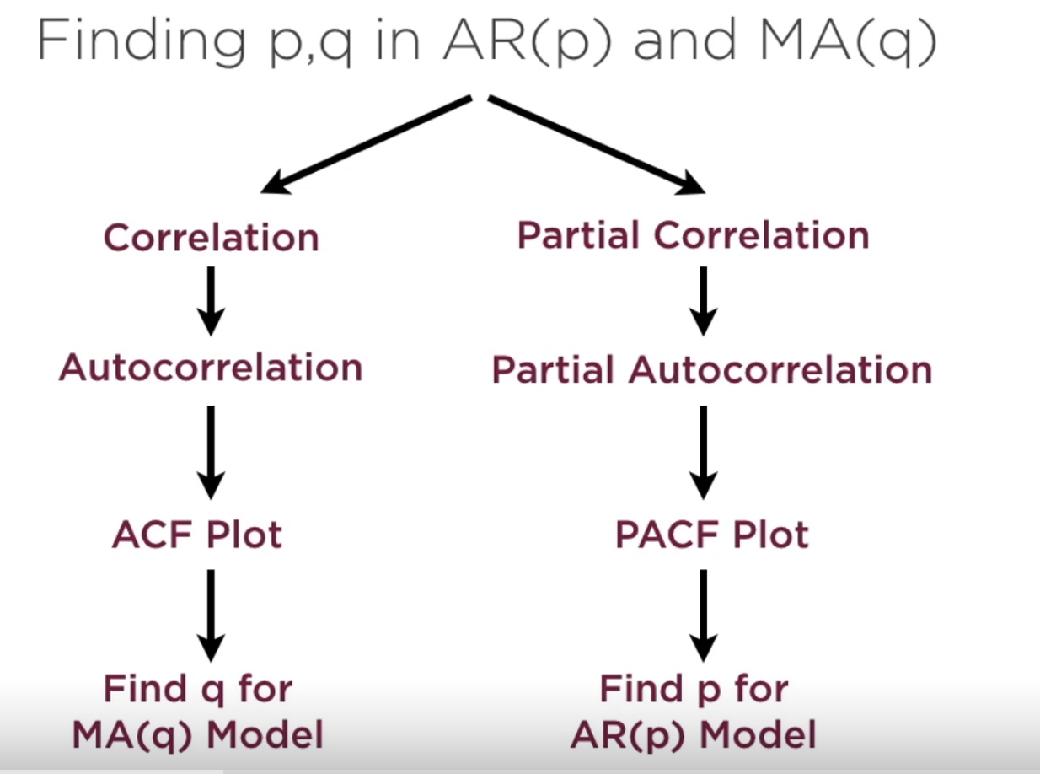
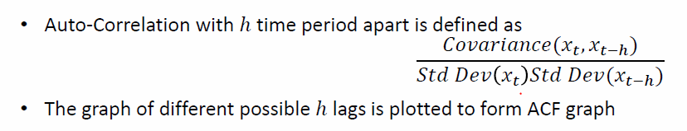

Model selection using ACF PCF

Slide 14
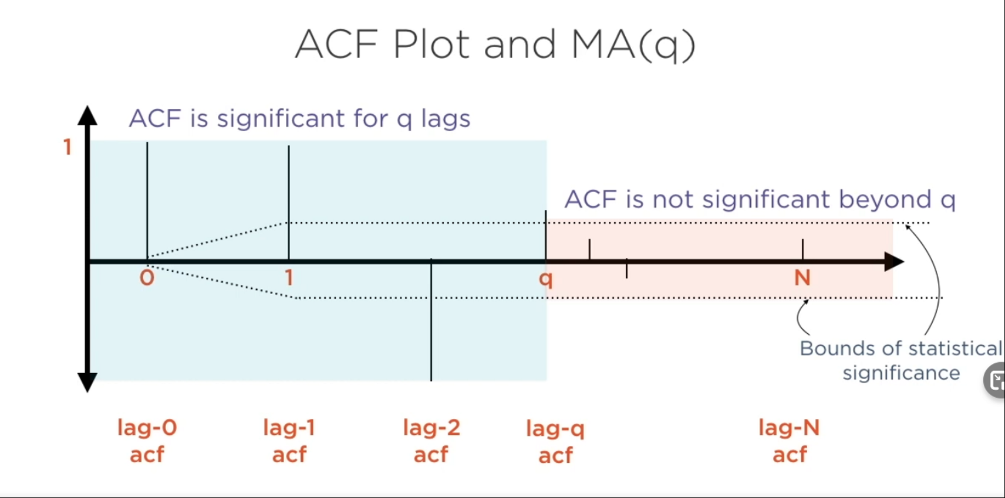
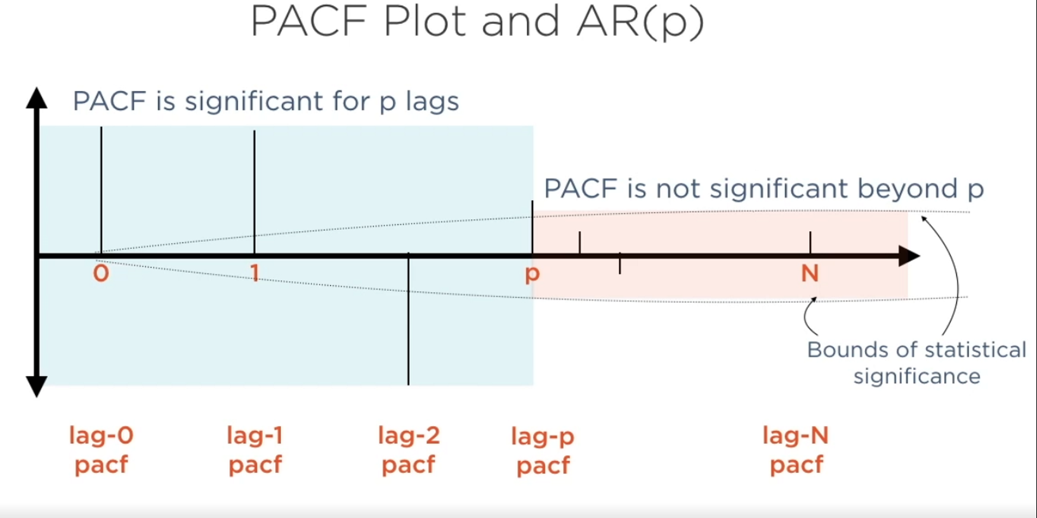
ACF and PACF plot

Slide 15
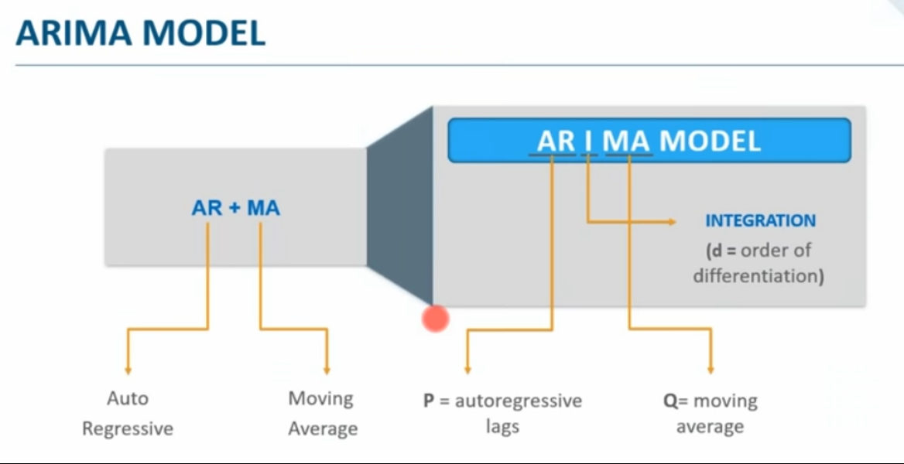
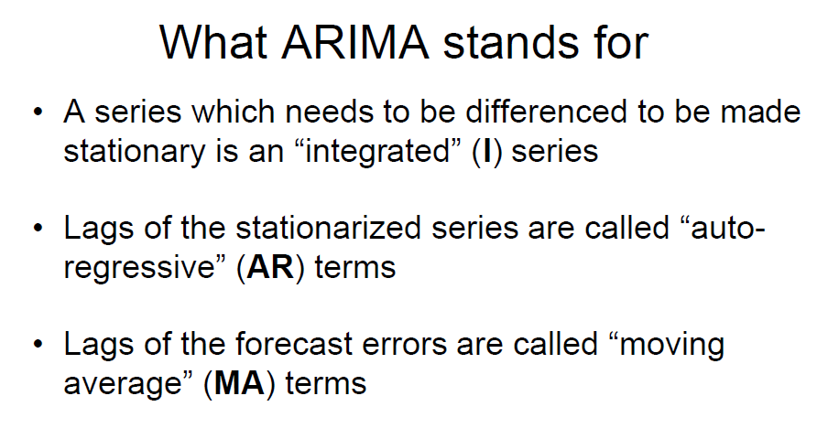
Arima Model
Auto Arima finds the values of P d Q automatically within a range of values

Slide 16
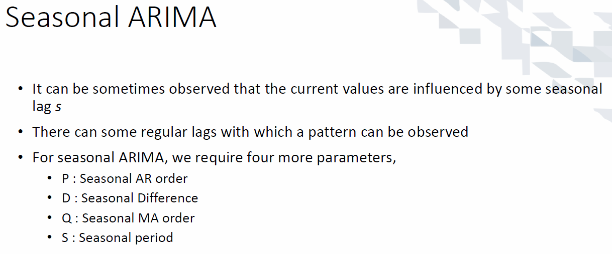
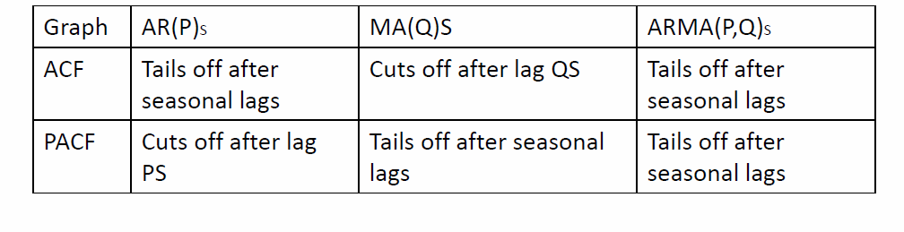
ARIMA for seasonal data

Slide 17
Limitations
They require lots of data
Some missing values can really effect the model
They assumes a Linear Relationship
Usually deals with univariate data
Not good when dataset have multiple inputs

Slide 18
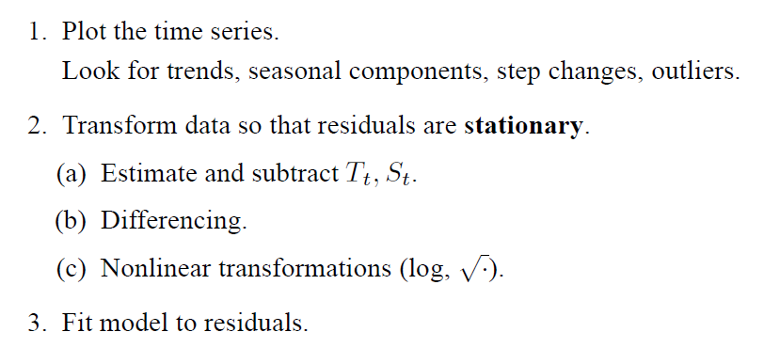
Recap (1)

Slide 19
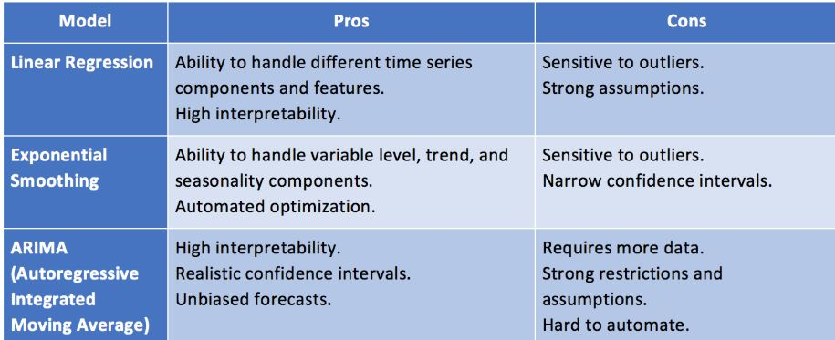
Recap (2)

